Slide 1

SUMMER OLYMPIC STATISTICS(1976-2008)
By P. SRAVANTHI
11805578

Slide 2
Introduction
Data Analysis – What, Why ?
World Suicide Rate analysis (1985-2016)
Process
Objectives
Observations
Dashboard – understandable for users

Slide 3
Data Analysis – What, Why ?
Process of cleaning, transforming and modelling data
Drawing conclusions from hidden patterns, getting meaningful insights
helps to know cause, solution and preventive steps or guess the trend

Slide 4
Process involved
Collect and process the data
Prepare tables and graphs
Analyze and interpret findings
Present it

Slide 5
Objectives
Year Wise Medals
Sports Wise Medals
Country Wise MedalsS
Country Wise Medals
Gender Wise Participation Each YearORTS-WISE MEDALS

Slide 6
Observations
Number of different medals in different countries over the years (1976-2008)

Slide 7
SPORTS-WISE MEDALS:
.

Slide 8
Country Wise Medals

Slide 9
ATHLETE FROM EACH CITY

Slide 10
GENDER WISE PARTICIPATION EACH YEAR

Slide 11
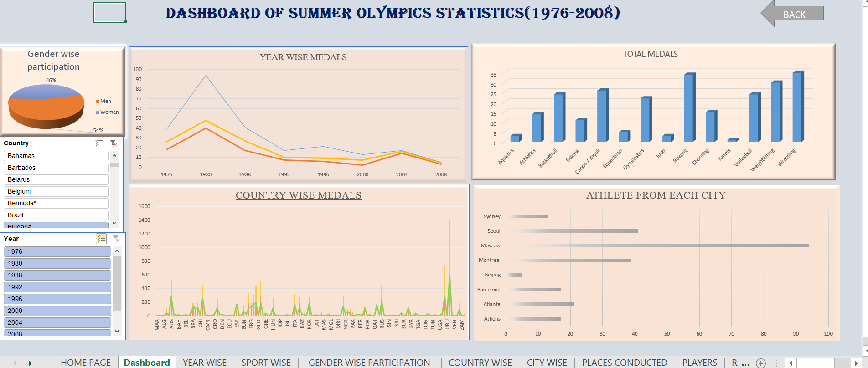
Dashboard

Slide 12
Thank you

